Slide 1

REVATURE PROJECT 3 DEV-OPS PIPELINEFORCE
April 2020 Revature Batch Trainer: August Duet
Notes:
Hello everyone - my name is Daniel Wallace. It is my pleasure to present to you today the Revature April 2020 batch Project 3 - DevOps Pipeline Force. The batch is focused on DevOps pipeline procedures using today’s trending software suites for automated solutions used within major software companies worldwide. This project is intended as a multifunctional pipeline to help development teams standup their applications in a streamlined manner - taking away the pains of understanding DevOps software - and letting them custom configure very few parameters with tools they are more familiar with such as Git - where a simple account & repository name will make this automated process painless for the developer to use.
In this project, I was the Scrum Master - the person that takes client needs from Revature’s project managers August Duet & William Gentry, and work with our team leaders for the certain software suites - Ansible, Jenkins, Spinnaker & Kubernetes. Together we designed the pipeline details and functionality to meet the client needs. Each team was comprised of Engineers that have become knowledgeable in their respective roles. With no further adue - I am pleased to hand this presentation off to Paityn Maynard to introduce you to the world of DevOps Engineering!

Slide 2

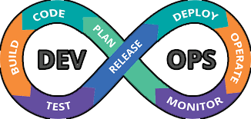

TEACH ME DEV OPS
What Is DevOps?
DEV OPS FOUNDER
PATRICK DUBOIS
Presenter:
Paityn Maynard
Notes:
Thank you Daniel! Good Day Everyone I am Paityn Maynard I am going tell you about what is DevOps and how It came to be!
So..
WHAT IS DEV OPS? (SPEECH) - Dev ops is the practice of combining software development and IT Operations to make the creation of software development faster and easier, while still maintaining high performing software. Okay so.. WHO CREATED DEV OPS?
Patrick Debois is said to be the founder after taking a project by the Belgian government, that left him in discontent after seeing the lack of cohesion and separation between the application development team and operations team.
DevOp Fun Fact:
In two thousand nine (2009), the first conference named devopsdays was held in Belgium. The conference was founded by Belgian consultant, project manager and agile practitioner Patrick Debois. The conference has now spread to other countries.

Slide 3

WHY DO WE USE DEV OPS?
Deployment to Clientele
Reduce Deployment Failures
Continuous Integration and Deployment
Load Testing
Application Monitoring
Presenter:
Paityn Maynard
Notes:
Knowing what is devOps Why do we use it? Well we
Use Devops to quickly be able to deploy new software to clientele for use in a production environment, allowing organizations to create and improve products at a faster than they can with traditional software development approaches
DevOp helps Reduce Deployment failures, rollbacks and time to recover.
This is achieved through Continuous Integration & Deployment which produces shorter development cycles with devops promote more frequent code releases - in turn making it easier to spot code defects-Also DevOps
DevOp Pipeline can integrate Load Testing & Application Monitoring through 3rd party softwares.
I would now like to pass it off to Austin to talk about the very start of our project,
Austin.

Slide 4
Ansible + Initializing the Pipeline
Notes:
Hello everyone, my name is Austin Kind and I served as the Team Leader for the Ansible group. Our group was responsible for the initialization of the pipeline.

Slide 5
Objective
To automatically initialize the pipeline with as little manual interaction as possible.
Presenter:
Austin Kind
Notes:
Our main goal for this stage was to streamline the process of creating a pipeline as much as possible and have almost every step be done automatically.
We wanted a Revature instructor to be able to pick a Caliber project for their batch to work on, fork that GitHub repository, then execute a script to automatically create a pipeline for that repository.
To accomplish this, we broke down the problem into four tasks that would have to be done to create this pipeline.

Slide 6
Approach
Write a bash script that asks for pipeline parameters
Create a parameterized Jenkins job template
Utilize Ansible to automatically initialize jobs and webhooks
Configure the Jenkins job to automatically send email notifications
Presenter:
Austin Kind
Notes:
Our first task was to write a bash script that would ask the user for the information needed to create the Jenkins job and set up the web hook.
In order to setup a web hook between GitHub and Jenkins, we needed the user to give us their GitHub information and repository url.
Our next task was to create a parameterized Jenkins job template we could pass these values to.
Using this template, we would be able to create the exact type of Jenkins job we needed given the parameters.
Next, we wanted to utilize Ansible to automatically create the Jenkins job based on the template and the given pipeline parameters.
In addition, we would use Ansible to setup a webhook for that GitHub repository.
Finally, our last task was to configure this Jenkins job to automatically send email notifications upon a build failure.
Now, I'm going to pass it on to Reggie, so he can talk more about what Ansible is, and why we chose to use it for this project.

Slide 7

What is Ansible?
A simple and flexible IT automation engine that can automate
cloud provisioning
configuration management
application deployment
Presenter:
Reginald Jefferson
Notes:
Hello, I'm Reginald Jefferson and I'm going to provide a little bit of information about Ansible.
So, what is ansible?
>Ansible is a simple and flexible IT automation engine that is able to automate several types of repetitive and tedious tasks which includes:
>>Cloud provisioning which is the setup of necessary servers and repos
>>Configuration management which includes starting and stopping services, installing and updating applications, the setup of security policies, and a variety of other configuration tasks
>>Application deployment which can make devops easier by automating the deployment of applications to production systems.
Which leads into why we chose to use ansible for this project.

Slide 8
Why Use Ansible For This Project?
Need to automate multiple tasks with a simple command
Communication with different hosts for job completion
Communicate with Jenkins to create jobs
Communicate with GitHub to create webhooks
Easy to parameterize
Presenter:
Reginald Jefferson
Notes:
Why use Ansible?
We had a need to automate multiple tasks with a simple command.
Those tasks featured communication with different hosts to complete specific jobs for the pipeline. We specifically needed to communicate with Jenkins to create jobs and we needed to communicate with GitHub to create webhooks.
Also, ansible is easy to parameterize which is great for repeated use with multiple projects spread accross multiple GitHub repositories. From here I will hand things off to Joshua to cover the job creation workflow.

Slide 9

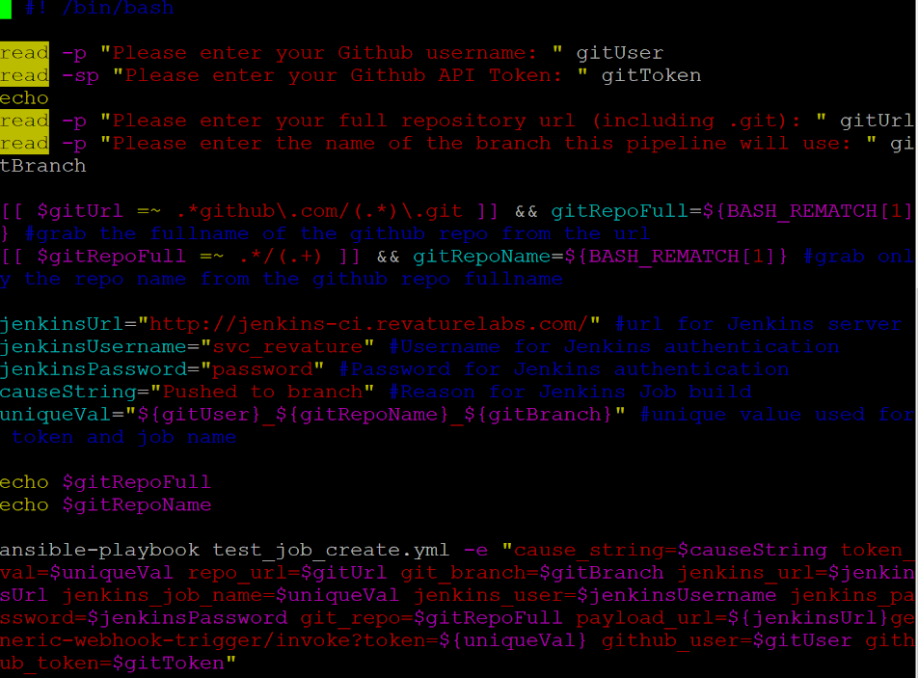

Job Creation Workflow
test_job_create.yml
Triggers Playbook
Creates Job from Template
Job: username_repositoryName_branchName
Presenter:
Joshua Brewer
Notes:
Talk about how the bash script initialized the process to create a job.

Slide 10
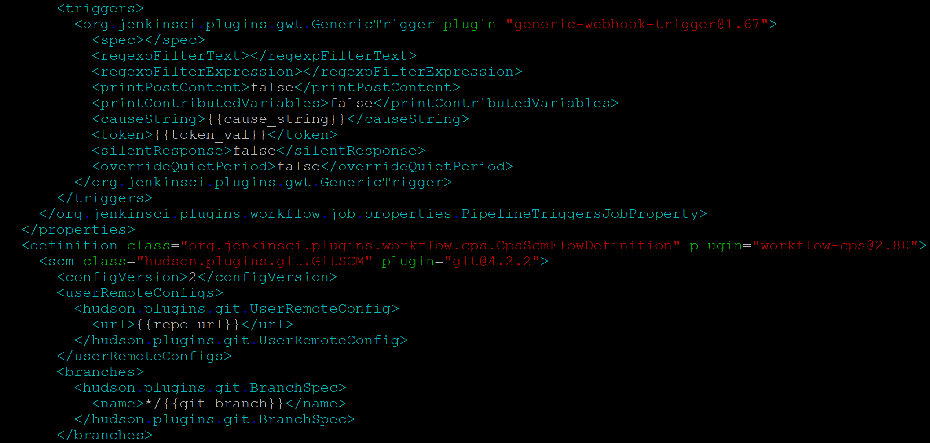
Parameterizing the Jenkins Job
Presenter:
Joshua Brewer
Notes:
Passing of parameters and generating unique job names based on a logical structure

Slide 11
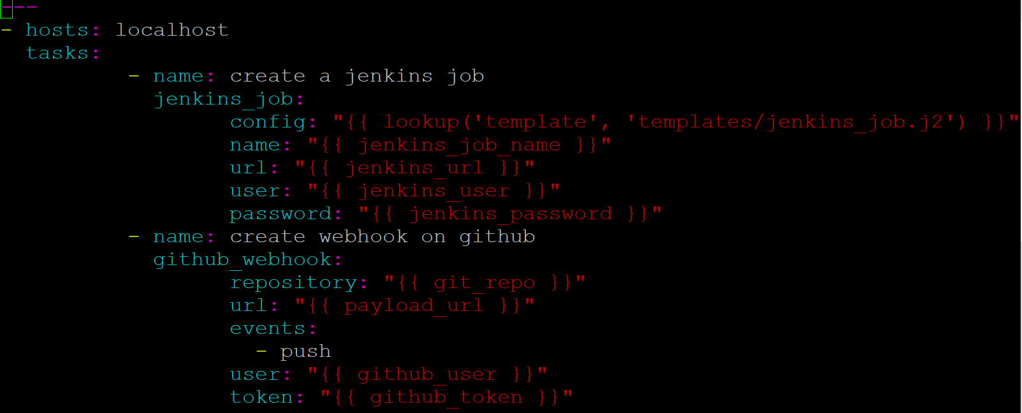
Writing the Ansible Playbook
Presenter:
Christopher Hill
Notes:
Ansible playbooks are nice and easy to write, and very configurable. Ansible playbook written in YAML which executes two separate modules, and the inputs are parameterized using variables to support the automated process. Here, Ansible’s Jenkins_job module creates a new job at the specified Jenkins server url, using the specified job template. We don’t want the trainer to have to set up webhooks themselves in github, so the github_webhook module will set up the webhooks automatically in GitHub, so that the new Jenkins Job runs automatically in response to push events on the repo.

Slide 12
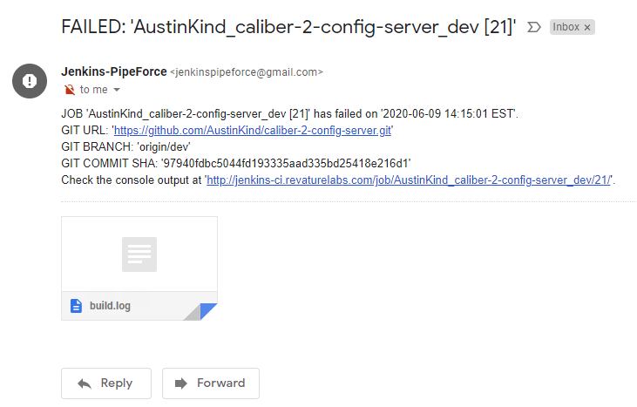
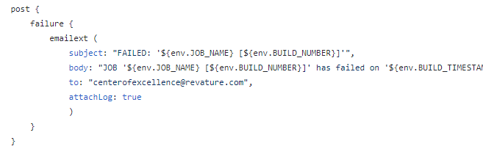
Adding Email Notifications
Presenter:
Christopher Hill
Notes:
Our final task was to have every Jenkins job automatically send email notifications in case of a build failure. In order to do this, we created an email to send these notifications called JenkinsPipeForce@gmail.com, and added a Post-Build step in the Jenkinsfile to send an email notification to the centerofexcellence@revature.com upon a build failure. In this email, we included the name and build number of the job that failed, along with the GitHub URL, branch, and commit SHA. In addition, we attached the logs of the build to show what error occurred.

Slide 13
Hurdles & Solutions
Hurdles:
Long wait to gain access to Revature’s AWS network
Large scope (Jack of all trades)
Our Approach:
Created our own Test servers for Jenkins and Ansible
Collaborated with other teams to determine Ansible role
Some roles are more suited towards other tools like Spinnaker or Jenkins
Presenter:
Dylan Tran
Notes:
Hi! I am Dylan Tran. While working with Ansible, our team faced some challenges that impeded our progress.
Our first setback was the delay in acquiring access to Revature’s AWS network which impacted our ability to create and run Ansible playbooks. We remedied this problem by creating our own test servers for Ansible and Jenkins.
Our second setback was the large scope of Ansible. As Ansible is an automation engine for many IT services, it could fulfill many roles, bringing confusion on the extent of how much we should implement. This was resolved through collaboration with the other teams to specify what roles Ansible was best suited for. For example, we were originally thinking of using Ansible for deployment, but decided on Spinnaker because it was better suited for this task.
Next Slide

Slide 14
Next Phase
Automate the ECR repo creation
Create a “Clean-up Playbook”
Delete unused Jenkins Jobs
Remove images created from builds
Presenter:
Dylan Tran
Notes:
Though our main tasks are complete, there were additional features we would like to implement during the next phase: The automation of ECR repository creation and a “clean-up” playbook
Automating the ECR repo creation through Ansible would save time as the project owner would no longer be required to manually create one if they chose to start a new Caliber project. Basically, the initialization process would be completely automatic and a new repo would be created if it did not exist.
A clean-up playbook would remove old Jenkins jobs and delete the images produced by those builds. This would be useful in keeping the Jenkins management site less congested and free up memory within the server.
Now, I will pass it over to Danarrius to explain more about Jenkins and its role in our project.

Slide 15
Jenkins
Presenters: Danarrius Broadway,
William Chung,
Damier Raymond

Slide 16

What is Jenkins?
How does it fit in DevOps?
What are benefits of Jenkins
How we implement it to our Project?
Presenter:
Danarrius Broadway

Slide 17
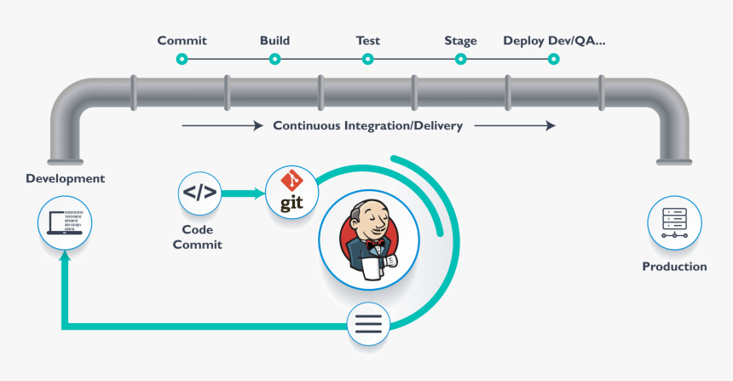
What is Jenkins ?
Jenkins is a open-source tool to automate Continuous Integration tasks
We can use Jenkins to:
Test code
Build application
Package project
Push package or image to registry
Presenter:
Danarrius Broadway
Notes:
an open source automation server which enables developers around the world to reliably build, test, and deploy their software. Also, by utilizing various plugins Jenkins makes it easier for developers to integrate changes to projects and, for users to obtain a fresh builds. This is know as continuous integration

Slide 18
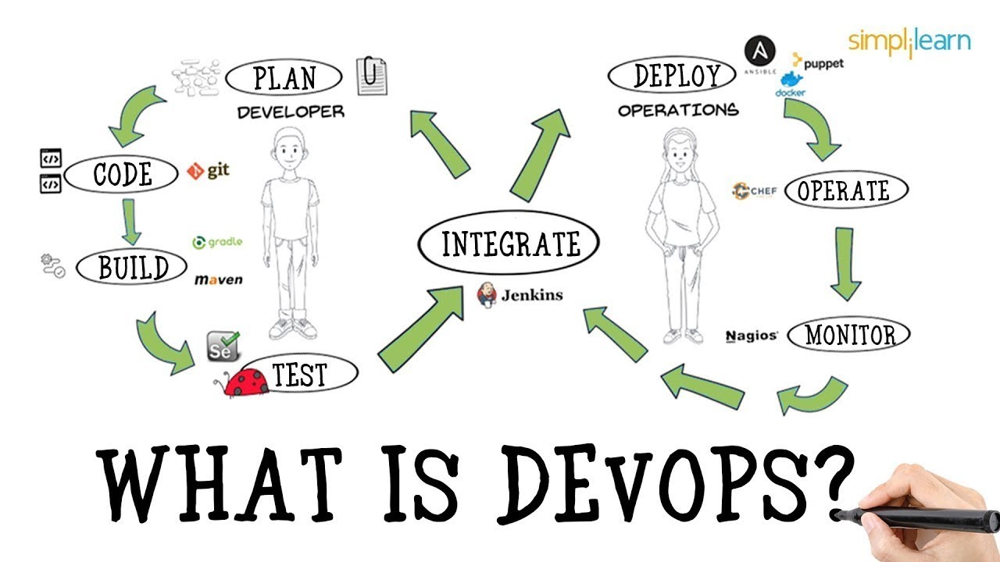
Jenkins’ role in the DevOps Process
Presenter:
Danarrius Broadway
Notes:
Continuous Integration is the most important part of the DevOps process that is used to integrate various DevOps stages. Jenkins is the most famous Continuous Integration tool. Jenkins has become the open source standard for managing the developer side of devops, from source code management to delivering code to production. ... Jenkins is a continuous integration (CI) and continuous delivery (CD) solution.

Slide 19
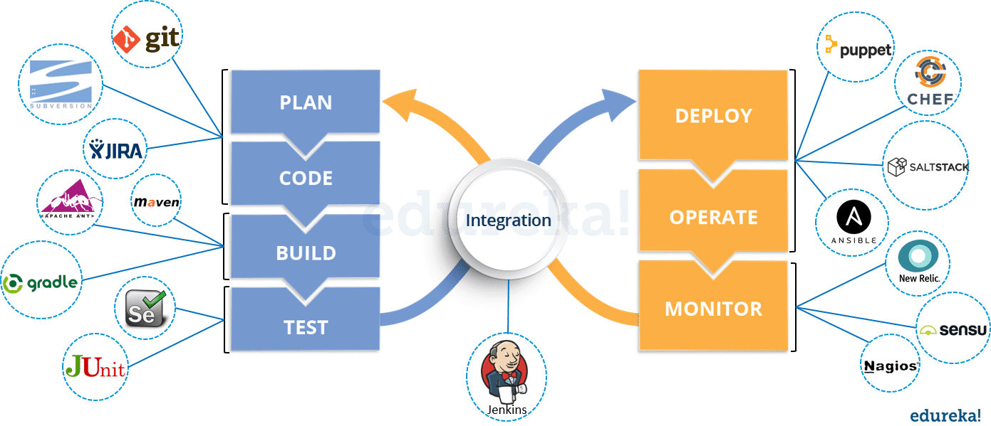
What are benefits of Jenkins ?
(History & Advantages)
Presenter:
Damier Raymond
Notes:
According to cloudBEES Jenkins project was started in 2004 (originally called Hudson) by Kohsuke Kawaguchi,while he was working at Sun Microsystems.Jenkins is an open source tool with much support from its community. It has more than 1000 plug-in to make the work easier.
It is easy to create new Jenkins plugin ( 1-just go to Manage Jenkins, 2- Manage Plugins then choose available plugins Hence it can be portable to almost all major platforms.

Slide 20
Implementation of Jenkins
Installed a Jenkins server onto AWS EC2
SSH into the Jenkins instance to install required tools and dependencies (Git, Maven, etc)
Configured Source Code Management to specify Repository URL (GitHub)
Used web gui to configure Jenkins and manage its plugins
Maven, angular, Sonar Scanner, email notification
Create the webhook for Ansible to trigger the Job
5) JenkinsFile (Declarative pipeline)
Once triggered by Ansible, Jenkins will run a Build with a Declarative pipeline specified in a Jenkinsfile
Presenter:
William Chung
Notes:
Hello, my name is William Chung.
To Implement Jenkins, we first had to install and run a Jenkins server. This Jenkins server was installed on an Amazon EC2 instance provided by Revature.
To Install Jenkins, we had to SSH into the instance and use Docker to pull the official Jenkins image and run it as a container. This container allowed us to access Jenkins as a web GUI by exposing a port on the instance. We also took the opportunity to install tools like Git and Maven, while we were were connected remotely.
With the web GUI running, we created users for the teammates to use and configured the Global settings like ECR, Docker, and GitHub credentials. We configured Source Code Management for GitHub by giving the repo URLs and specifying the branches to pull (dev branches). We also installed and configured plugins for Maven, Angular, Sonar Scanner, and Email notifications.
A Trigger was also created for Ansible to call upon Jenkins to start the Build pipeline for a specific Job or project.
next slide

Slide 21
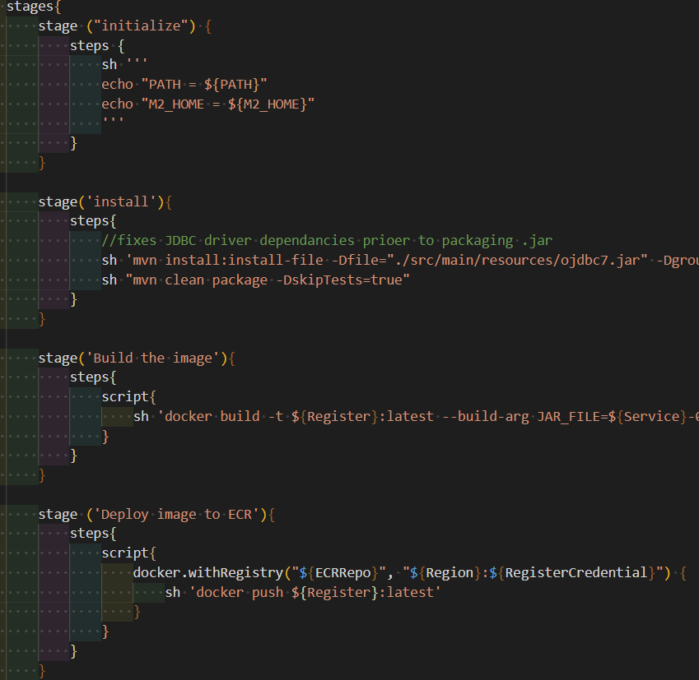
Jenkinsfile - Pipeline as Code
Configured with a Declarative pipeline using a Jenkinsfile.
Jenkinsfile is commonly written in Groovy language.
A Build happens in “Stages”, such as ‘Testing’ or ‘Building’ or ‘Pushing Image’.
Stages happen in “Steps”, where shell commands and functions can be executed.
Presenter:
William Chung
Notes:
A Jenkins Build is one instance of a Project or Job pipeline running from start to finish.
The Build is carried out declaratively by a Jenkinsfile, located usually at the root directory of the project. This Jenkinsfile is written in Groovy, a language built on top of Java with the benefit of loose types.
The Jenkins Build and its Declarative Jenkinsfile is comprised of “Stages”, which we give readable names such as “Initialize” or “Build image” or “Deploy Image to ECR”. These Stages are themselves comprised of “Steps”, which are the individual bits of instruction for the pipeline. Steps can range from any executable groovy function previously defined, to shell commands to the linux OS, or CLI commands using docker, maven, or any other plugin or tool being used.
I pass the next slide to my teammate Damier.

Slide 22
Challenges
Configuring Plugins
Waiting for Credentials
ssh the Jenkins instance
have the correct plugins for the pipeline to be running
we have 2 separates file configuration
Jenkinsfile ( Java and Angular )
Way we Overcome all of that:
Presenter:
Damier Raymond
Notes:
for the java we familiar with it so well because we been train for that in the entire training of program with the previous project.
the handicap was with Angular and Nodejs file project every time we build the image, it did not like the instation where the module and package-lock.json (Image size 682.1 MB)

Slide 23

Future works
The current Pipeline is compatible with Java/Spring and Angular projects.
We hope to increase this flexibility to support any type of project.
Presenter:
Damier Raymond
Notes:
We learn a lot in this training, we gain experiences especially in our task assigned, for us it was Jenkin task responsibility
we fill more comfortable by now and look forward for the work environment experiences

Slide 24

SPINNAKER
Notes:
Good day everyone!! Once more I am Paityn Maynard I will be introducing Spinnaker and its role in our DevOps Pipeline

Slide 25
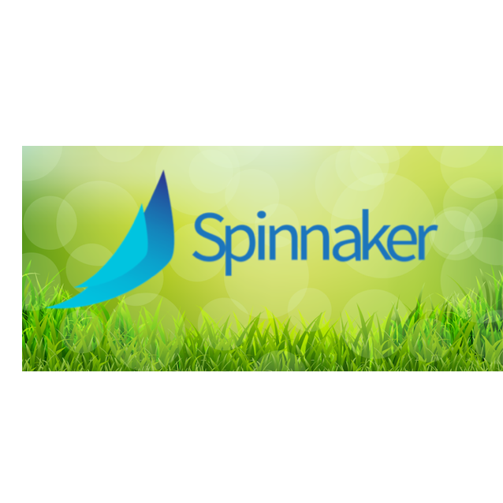
Spinnaker
Spinnaker has two core features:
Application management
Application Deployment
Presenter:
Paityn Maynard
Notes:
Spinnaker is an open-source, CD platform that helps you release software changes with ease and speed
Application Management meaning viewing and managing Cloud Resources
Application Deployment meaning sending the application to our Kubernetes Cluster
In Our Project We used it to continue the DevOPs Pipeline from where Jenkins leaves off
Moving us from a Continuous Integration Pipeline to a Continuous Deployment Pipeline
A pipeline in Spinnaker, is the key deployment management construct .It consists of a sequence of actions, known as stages.
We utilized the Spinnaker’s Bake and Deploy Stages which Bart will go into more detail later
To talk about the goals we had for Spinnakers I am going to turn it over to Johnny

Slide 26
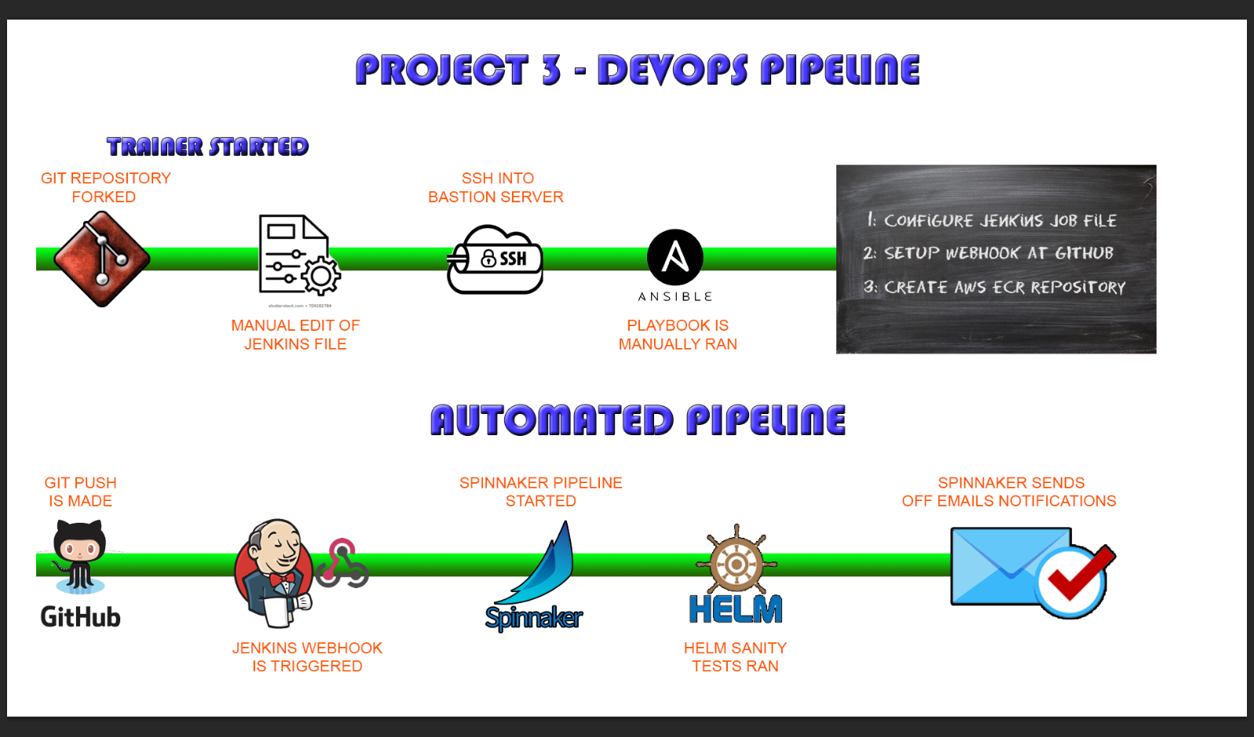
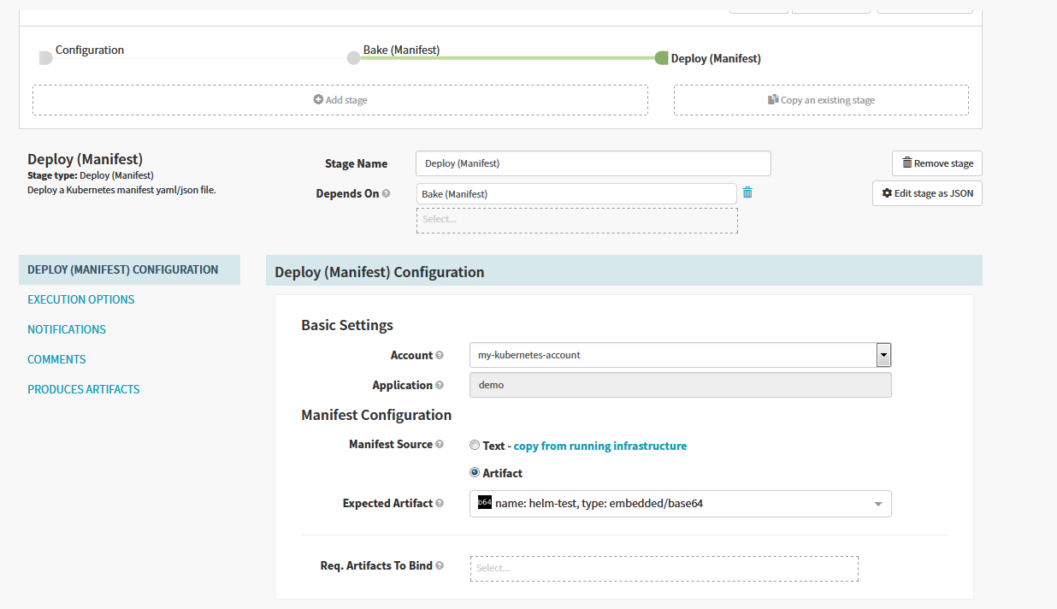
What Were The Goals?
Pick up pipeline after Jenkins
To Bake Helm Charts
To Deploy Artifacts to Kubernetes Cluster
Presenter:
Johnny Sheerin
Notes:
Thank you Paityn, my name is Johnny Sheerin: and now that everyone has a basic understanding of how spinnaker contributes to application management and continuous delivery, I am here to tell you guys how our team used Spinnaker to achieve continuous delivery in our Dev/Ops Pipeline.
Although Spinnaker can also be an application management tool we chose to use it strictly for the continuous deployment side.
Once Jenkins is done with its pipeline, Spinnaker would pick up. Pulling the helm charts from a s3 Spinnaker will build an artifact that would allow deployment through a kubernetes cluster. This is part of a stage called baking. Once the artifact is baked. Spinnaker would move into its deployment stage of the pipeline. Spinnaker will automatically deploy the baked artifact to our Kubernetes cluster. If the artifact is successfully deployed to the kubernetes cluster spinnaker has done its job in achieving continuous deployment.
Thank you everyone for listening, again my name I Johnny Sheerin. I will now hand you off to Bart who will go into more detail about the stages of spinnaker.

Slide 27
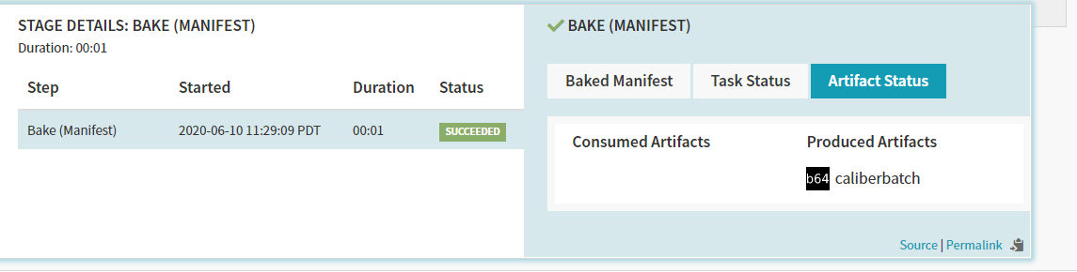
Bake
Pull Helm Charts from S3
Builds Artifact using Charts
JSON object matching specification, not actual contents
Reference to resource, not actual resource
Stage takes in “expected Artifact” (pointers to S3 charts)
Creates Artifact that encapsulates resource and metadata
Presenter:
Bart Martinon
Notes:
Thank you Johnny, my name is Barthelemy Martinon and I will quickly discuss the two stages of which defines Spinnaker’s role in our project.
Baking here refers to the process of creating a machine image.
It pulls Helm charts from the S3, and uses those charts to build an artifact.
An artifact is a JSON object matching this specification, not the actual artifact contents. The key distinction is that the artifact is a reference or a pointer to a resource, not the resource itself.
The bake stage takes in the “expected artifact”, in this case this artifact points to the helm charts on the S3.
Then the stage creates another artifact, which encapsulates the resource being brought in (helm charts) and other metadata (like type, URI to resource, the account that fetched it, version [for comparing artifacts with the same name and type], other stuff).

Slide 28
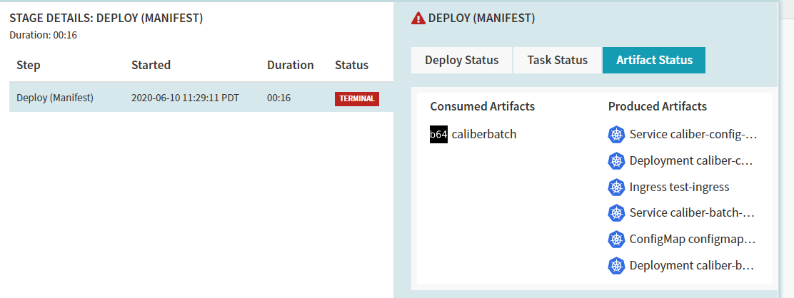
Deploy
Takes the the artifacts produced by the bake stage and deploys it to the cluster using helm.
Pulls the Helm chart from the AWS S3.
Pulls the docker image from the AWS ECR.
Deploys the container using the helm chart.
Presenter:
Bart Martinon
Notes:
Deploy the previously baked or found image using the specified deployment strategy.
(In theory, we’d use the red/black / blue/green deployment strategy)
Takes the artifact produced by bake, and deploy to the cluster. Uses helm, since the resource being baked was a helm chart.
Next up, Jordan Severance will go over all of which we have accomplished as part of the Spinnaker team at this time, as well as hurdles that came up.

Slide 29
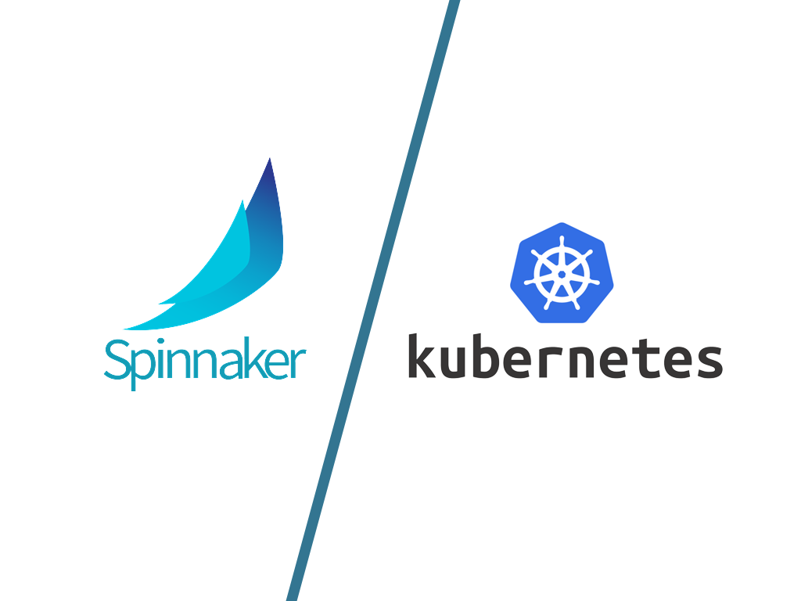
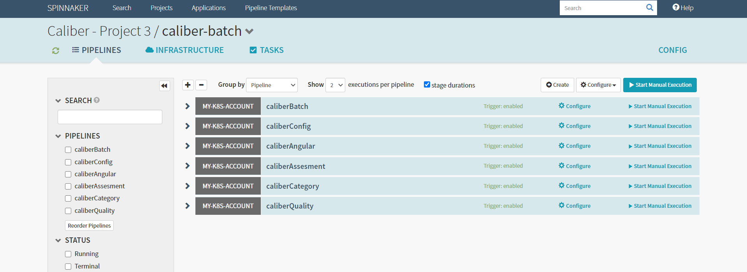
Accomplishments
Spinnaker is installed in the Kubernetes Cluster
Pipelines are templated and in Spinnaker Application
Presenter:
Jordan Severance
Notes:
Thanks Bart! Hello everyone, my name is Jordan Severance and I am the team lead for the spinnaker team. I’m going to talk about some of the work that we got done and some of the issues that we ran into.
Spinnaker has been installed on the Kubernetes cluster. This installation and deployment was an arduous process at times, so we have created very detailed documentation to help with the process.
Accounts with certain permissions are necessary at the time of configuration, and running into these without forewarning can put a big hold on the installation process.
Additionally, pipelines are set up and available for the Calibur applications.
these pipelines can easily be edited and updated as needed

Slide 30

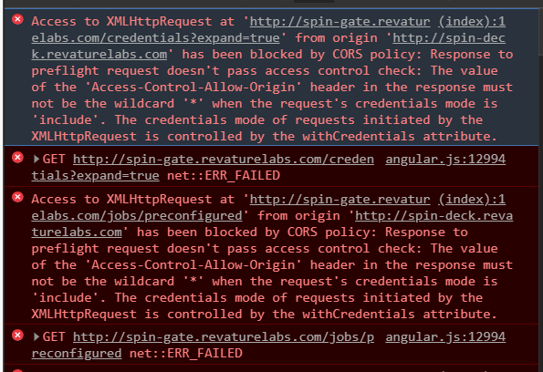
Hurdles
Waited for user accounts and authentifications
Extended R&D
Compressed hands on time
Spinnaker Documentation Not Thorough
Communication issues between UI (spin-deck) and API (spin-gate)
Communication is blocked
CORS issue
We have been working with assisting cloud specialist Uday and our trainer August on this issue
Deploy Stage did not act as expected or documented
Presenter:
Jordan Severance
Notes:
At the beginning of the project we experienced a start and stop process; we had to wait for accounts, permissions and authentications to be created for us
unfortunately this extended our R&D while compressing the amount of time we could get our hands on the application and learn to use it outside of a purely theoretical setting
This was especially detrimental because the documentation available for Spinnaker is often out of date and relates a level of ease of use that we did not observe when using the program
One of the biggest problems we faced occured when exposing the ui on a DNS or even visiting the ELB address.
We’ll go into more detail shortly, but basically communication is consistently blocked between the UI and API, making the UI unusable.
we have worked closely with our trainer August and our cloud specialist Uday to mitigate this issue, but have not found a working solution yet
In a couple of minutes, we’ll describe a temporary solution to that problem. After enacting that solution, we have noticed that the Deploy Stage does not act as we expected
Unfortunately, due to time constraints we were not able to fully solve this problem.
Now I’m going to hand you over to Dylan Chhin who will discuss some of the solutions we have attempted to solve our problems
when implementing a Blue/Green Deployment, we must specify a Load Balancer for the service.
By doing so, Spinnaker does not like the fact that this service is also prescribed in the helm charts that we pull in during the Bake Stage.
Possible solution: ingress to front all the services?

Slide 31

Solution Attempts
Load Balancers for UI and API
Reachable, Console shows error stream, timeout
Added expected CORS pattern by editing config file
Through Halyard
Manual addition
No change in results
Made DNS addresses instead of ELB addresses
Timeout issue resolves
UI reachable but not talking to API
Presenter:
Dylan Chhin
Notes:
In reference to exposing the UI and interacting with Spinnaker and it’s features
Solution 1
Made load balancers for UI and API
Can hit UI but not the api and then timed out errors in console stream
Solution 2
Problem stemming from a cors pattern issue
tried adding cors pattern, but according to docs it shouldn't be necessary
Halyard Command
Adding line to config file
No effect
Solution 3
Make DNS address instead of ELB addresses
If elb went down then the services went down
Static dns address, made it more accessible
With the help of Uday and August, able to reach the UI without timeout but same problem with CORS

Slide 32

Temporary Working Solution
Use default of directing UI to localhost:9000 and API to localhost:8084 on pod
Use kubectl port forwarding to route traffic to ports 9000 and 8084 on the pod from those ports on the local machine
Not a permanent solution
unstable
not extensible
Presenter:
Perry Lee
Notes:
Reset URL of deck (UI) and gate (API) to bind to their default ports on localhost
From the hal pod where halyard is installed, run hal deploy connect to connect to Spinnaker. Internally, this forwards localhost on the hal pod to the respective ports on the deck and gate services
Run kubectl port-forward pod/(hal pod) 8084 9000 to forward traffic on our localhost machine to localhost on the hal pod
This works, but it’s not a great solution...it’s not very stable, definitely not maintainable...have to restart port-forwarding every so often
In future, want to find a more proper solution to UI/API issues. Lead into Shawyn’s slide...

Slide 33

Future Work
Get the UI exposed more effectively
Add authentication to mitigate CORS problems?
Incorporate Spinnaker throughout the pipeline
Trigger on github
Run jenkins jobs
Automate process of creating Spinnaker pipeline
Dinghyfile
Spin cli
Configure notifications to email address
Presenter:
Shawyn Kane
Notes:
Thank you Perry. Hey I’m Shawyn Kane.
I will be going over the work we will be doing in the future.
One of the things we would like to do is get the Spinnaker UI more effectively exposed.
We will try to do this by adding some authentication that would allow us to modify the values in the http request headers.
This would help us to avoid the CORS problem that we ran into and allow us to better control who has access to the Spinnaker pipeline.
Another thing we want is to incorporate Spinnaker into the entire pipeline.
This would be from the end of continuous integration phase, to telling Jenkins to run it’s jobs for building and baking, to implementing the deployment stage of the pipeline.
We also want to automate the process of creating Spinnaker pipeline by using cli commands to load and save the pipeline to a file.
We need to incorporate notifications to know when and where the pipeline fails and when it is successful.
I will pass it off to the Helm and Kubernetes team.

Slide 34

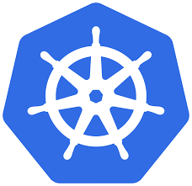
KUBERNETES & HELM
Presenter:
Rayan Vakil
Notes:
Kubernetes was used for container orchestration, while as Helm was used for streamlining installing and managing Kubernetes applications.

Slide 35
Kubernetes
Orchestrate docker container services
Containers consist of all the components a program or process needs to run.
A pod is a structure containing one or more containers
Replicates the pods to allow load balancing and build failure resistance.
Spinnaker also resides in the cluster
Features:
Automating manual processes
Self-healing
Scaling
Storage orchestration
Automated rollout and rollback
Container tech to achieve end-to-end automation, ensuring CD.
Presenter:
Rayan Vakil

Slide 36
Helm
Package, configure, and deploy applications and services onto Kubernetes clusters.
Install software.
Automatically install software dependencies.
Upgrade software.
Configure software deployments.
Fetch software packages from repositories.
Helm provides this functionality through the following components:
Helm
Tiller
Charts
Helm hub
Presenter:
Rayan Vakil

Slide 37
Implementation
Created Docker Images
Wrote deployment and service YAML files
Wrote an Ingress YAML file
Created Helm chart and stored appropriate YAML files
Tested Helm chart
Presenter:
Joshua Ragasa
Notes:
Joshua Ragasa
Hi! My name is Joshua Ragasa. I will be speaking on what the Kubernetes team did and the challenges we faced in Pipeline Force
First, we built Docker Images for each service of Caliber and pushed them onto a Docker Hub repository so that our team could have access to caliber.
Wrote the appropriate YAML files to create deployments and services for each Caliber service
We wrote an ingress file that exposes the Caliber services to an outside network
Created a Helm chart to then be able to store the appropriate YAML files within the template directory
Finally, we tested the Helm chart so that it could be run on a Kubernetes cluster.

Slide 38
Challenges with Caliber
Caliber
Lack of documentation
Application tests were often unrunnable
Adapting to Spring
Minimal exposure to Spring
Extra time spent on understanding and researching
Presenter:
Joshua Ragasa
Notes:
Joshua Ragasa
One of the real challenges we faced with Caliber was the lack of documentation
We would expend a lot of time digging into the code to try to find the bits and pieces we would need to use for certain configurations.
Even when we get to a point to where we could run the applications, the Caliber tests would often fail or be unrunnable.
Through problems with the services themselves, would later domino effect into the other software that would try to run the application’s tests.
Another challenge was adapting to Spring. Due to no working knowledge of the Spring Framework, we would spend a lot of time researching it and what we need as far as configurations and functionalities.

Slide 39
Challenges with Helm and Kubernetes
Learning basic GO
Add dynamic functionality within the YAML files
Navigating the Helm and Kubernetes documentation for setting up a deployment
Port mapping configurations
Setting up environment variables
Presenter:
Joshua Ragasa
Notes:
Joshua Ragasa
On to challenges with Helm and Kubernetes
One challenge was learning basic GO to add dynamic functionality within the Chart and Value YAML files.
The value YAML was especially important because it allowed for implementing environment variables.
Another challenge was Navigating the limited Helm and Kubernetes documentations to find the most appropriate solution for setting up a deployment.
Lastly, one of the biggest hurdles we had to face was creating the port mappings to be used on a Kubernetes cluster or with Spinnaker.
I will now pass it on to Greg to talk about the hurdles we overcame.

Slide 40
Helm Hurdles Overcome
Implementation of Google’s Go within helm charts
Enables dynamic creation of charts through the use of variables
Building templates and charts
Aids in the successful deployment of the kubernetes cluster
Manipulate the YAML to match external configurations
Files needed to match the configuration of Caliber
Presenter:
Gregory Cox
Notes:
I will be going over some of the hurdles that the helm team had to overcome as well as some additional features that could have been added if we had more time.
Firstly, our team had to learn to work with Google’s Go-lang within helm charts in order to parameterize them so that their creation could be dynamic
Secondly, we worked with templated charts within helm to automate the deployment of our kubernetes cluster.
One last hurdle that we had to overcome was ensuring that our YAML files properly matched Caliber’s configuration before our helm charts were able to be deployed.

Slide 41
What can be done with more time?
The creation of a bash to be run with Ansible
Deployments
Ingress
Configmaps
Some additional files
Values
Secrets
Presenter:
Gregory Cox
Notes:
So what are some things that we would have done if we had more time?
One thing we could have done is created a bash script that could be run through Ansible in order to configure custom YAML files for specific microservice architectures
Some examples of custom YAML files that could be created with bash scripts include:
We could have automated the creation of deployments which would specify the number of replica sets, exposed ports, image names, and locations. An Ingress which would expose the cluster to external traffic and provide static IPs for each service could have also been created through a script. Lastly, external configuration could be setup through the use of config maps.
Some additional files that could be created in the future:
A values Yaml file in order to centralize the placement of GO variables which would make it faster and easier to manage them. Also a secrets yaml file could have been used in order to hide sensitive information.
: communication between pods through a designated pod

Slide 42

LETS SEE A DEMONSTRATION!
Presenter:
Jean Aldoph II
Notes:
Without further ado I am going to hand it off to Jean Aldoph who will now be demonstrate the use of our pipeline.

